Slide 1
Nested Loops
Nested loop: loop that is contained inside another loop
Example: analog clock works like a nested loop
Hours hand moves once for every twelve movements of the minutes hand: for each iteration of the “hours,” do twelve iterations of “minutes”
Seconds hand moves 60 times for each movement of the minutes hand: for each iteration of “minutes,” do 60 iterations of “seconds”
for ……. in range(n):
for ……. in range(x):
print()

Slide 2
Print the following output by using nested for loop
Hr Min(0-59) sec (0-59)
0 0 0-59
0 1 0-59
0 59 0-59
1 0 0-59
1 1 0-59
1 59 0-59

Slide 3
for hours in range(12):
for minutes in range(60):
for seconds in range(60):
print(minutes, ':', seconds)
Hr Min(0-59) sec (0-59)
0 0 0-59
0 1 0-59
0 59 0-59
1 0 0-59
1 1 0-59
1 59 0-59

Slide 4
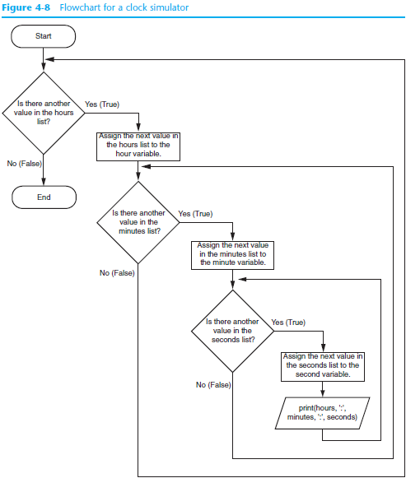

Slide 5
Nested Loops
Nested loop: loop that is contained inside another loop
Try for printing months, weeks and days

Slide 6
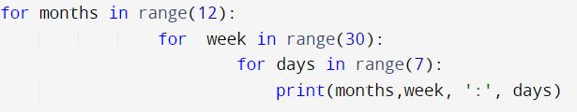
Nested Loops
Nested loop: loop that is contained inside another loop

Slide 7
Nested Loops (cont’d.)
Key points about nested loops:
Inner loop goes through all of its iterations for each iteration of outer loop
Inner loops complete their iterations faster than outer loops
Total number of iterations in nested loop: number_iterations_inner x
number_iterations_outer

Slide 8
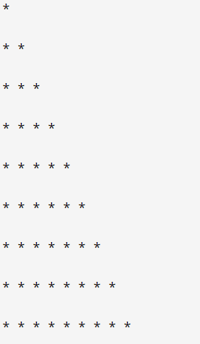
How do you produce the following pattern by using nested loop

Slide 9
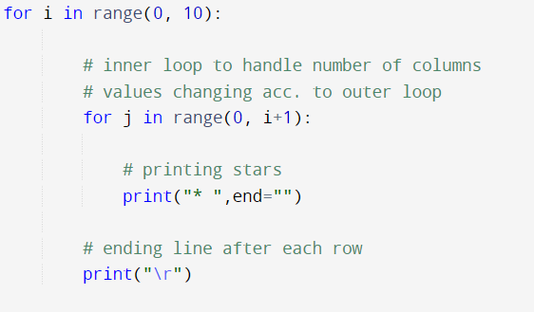
How do you produce the following pattern by using nested loop

Slide 10
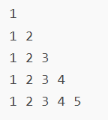
How do you produce the following pattern by using nested loop

Slide 11
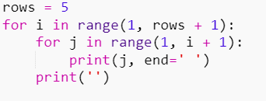
How do you produce the following pattern by using nested loop

Slide 12
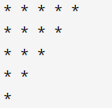
How do you produce the following pattern by using nested loop

Slide 13
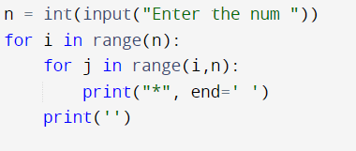
How do you produce the following pattern by using nested loop

Slide 14
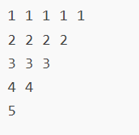
How do you produce the following pattern by using nested loop

Slide 15
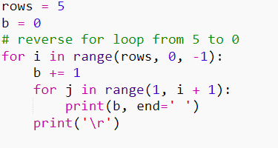
How do you produce the following pattern by using nested loop

Slide 16
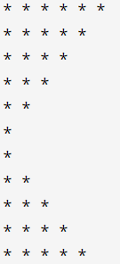
How do you produce the following pattern by using nested loop

Slide 17
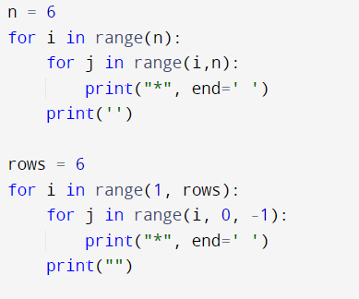
How do you produce the following pattern by using nested loop

Slide 18
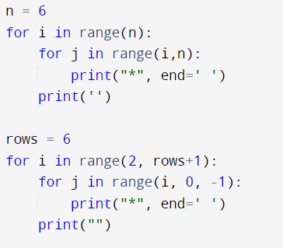
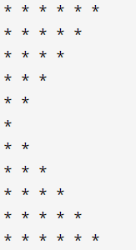
How do you produce the following pattern by using nested loop

Slide 19
How do you produce the following pattern by using nested loop

Slide 20
How do you produce the following pattern in which the number of columns and rows is dictated by the loop indices?
XXXXXX
XXXXXX
XXXXXX

Slide 21
How do you write a program that produces:
XXXXXX
and then skip to a new line?
for j in range(6):
print(‘x’, end = ‘’)
print() # skips to a new line
How do we repeat this pattern 3 times?
We nest
for j in range(6):
print(‘x’, end = ‘’)
print() # skips to a new line
in another loop

Slide 22
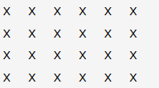
Nesting of Loop
Print the following output

Slide 23
Breaking out of loop
The break statement ends the current loop and jumps to the statement immediately following the loop
It is like a loop test that can happen anywhere in the body of the loop
while True:
line = input('> ')
if line == 'done' :
break
print (line)
print ('Done!‘)
> hello there
hello there
> finished
finished
> done
Done!

Slide 24
Breaking out of loop
True ?
Yes
while True:
line = input('> ')
if line == 'done' :
break
print (line)
print ('Done!‘)
....
break
...
print 'Done'

Slide 25
Breaking out of loop
program to find first 5 multiples of 6 using break statement

Slide 26
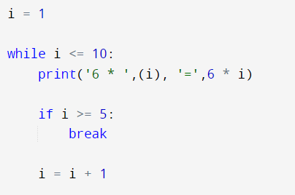
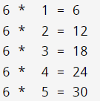
Breaking out of loop
program to find first 5 multiples of 6 using break statement

Slide 27
Finishing an Iteration with continue
The continue statement ends the current iteration and jumps to the top of the loop and starts the next iteration
while True:
line = input(‘> ')
if line[0] == '#' :
continue
if line == 'done'
: break
print (line)
print ('Done!‘)
> hello there
hello there
> # don't print this
> print this!
print this!
> done
Done!

Slide 28
while True:
line = input(‘> ')
if line[0] == '#' :
continue
if line == 'done'
: break
print (line)
print ('Done!‘)
No
True ?
Yes
....
....
continue
...
...
print 'Done'

Slide 29
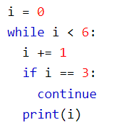
Finishing an Iteration with continue

Slide 30
Pass Statement
The pass statement is used as a placeholder for future code.
When the pass statement is executed, nothing happens, but you avoid getting an error when empty code is not allowed.
Empty code is not allowed in loops, function definitions, class definitions, or in if statements.
Example:
a = 33 b = 200 if b > a: pass
a=7
b=33
if a>b:
print(b)
a=7
b=33
if a>b:
pass
print(a)
print(b)

